Slide 1
Gesture Project
Zehua Yu G00307279

Slide 2
Introduction Of Project
My project is Unity game and controls the operation by Myo sensor.
This game is to drive the motor going to the destination. The using Myo sensor to controls power, brake and rotation.

Slide 3
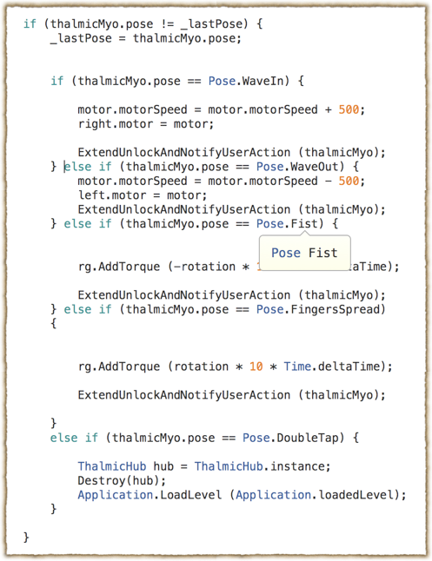
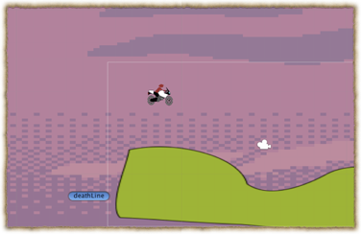
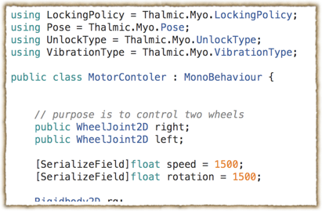

Slide 4
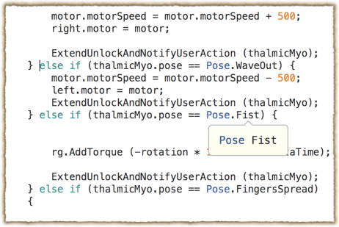
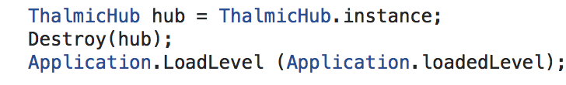
Code Explanation
the right code graph shows how to use the Myo sensor to update the value in order to move the motor.
The Myo official website gives the a example of unity and explanation, needs to import the package.
when the game over, the process needs to close the Myo connection.

Slide 5
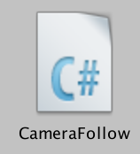
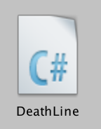
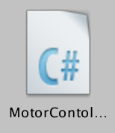
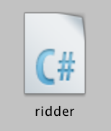
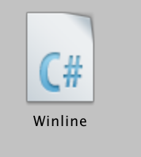
user perspective
The conditions of judgment
update the value to control the motor

Slide 6
Set Up
Import the Myo example Package
add the Hub-Myo
add the Myo class to unity setting

Slide 7
Introduce of Gestures
wave in : going forward
wave out: going back
fist: clockwise rotation
FingersSpread: anticlockwise
DoubleTap: restart

Slide 8
